Slide 1

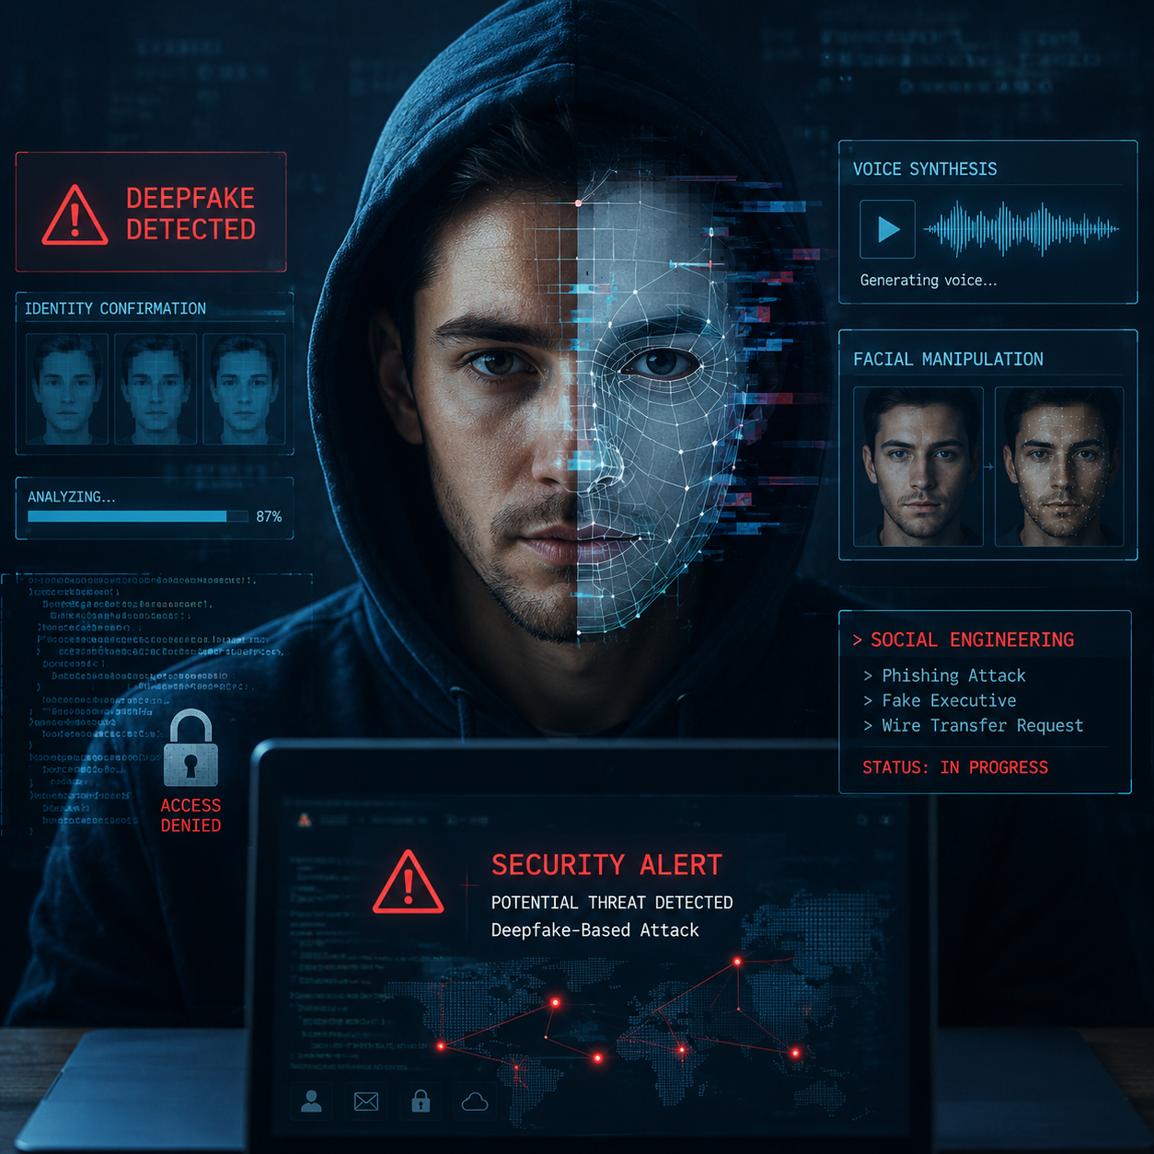
The Use of Deepfake Technology in Modern Cybersecurity Attacks
Name: Guy Shitrit
Department: Software Engineering
Course: Advanced B
Lecturer: Anrieta Levi
Date: 2.6.26

Slide 2
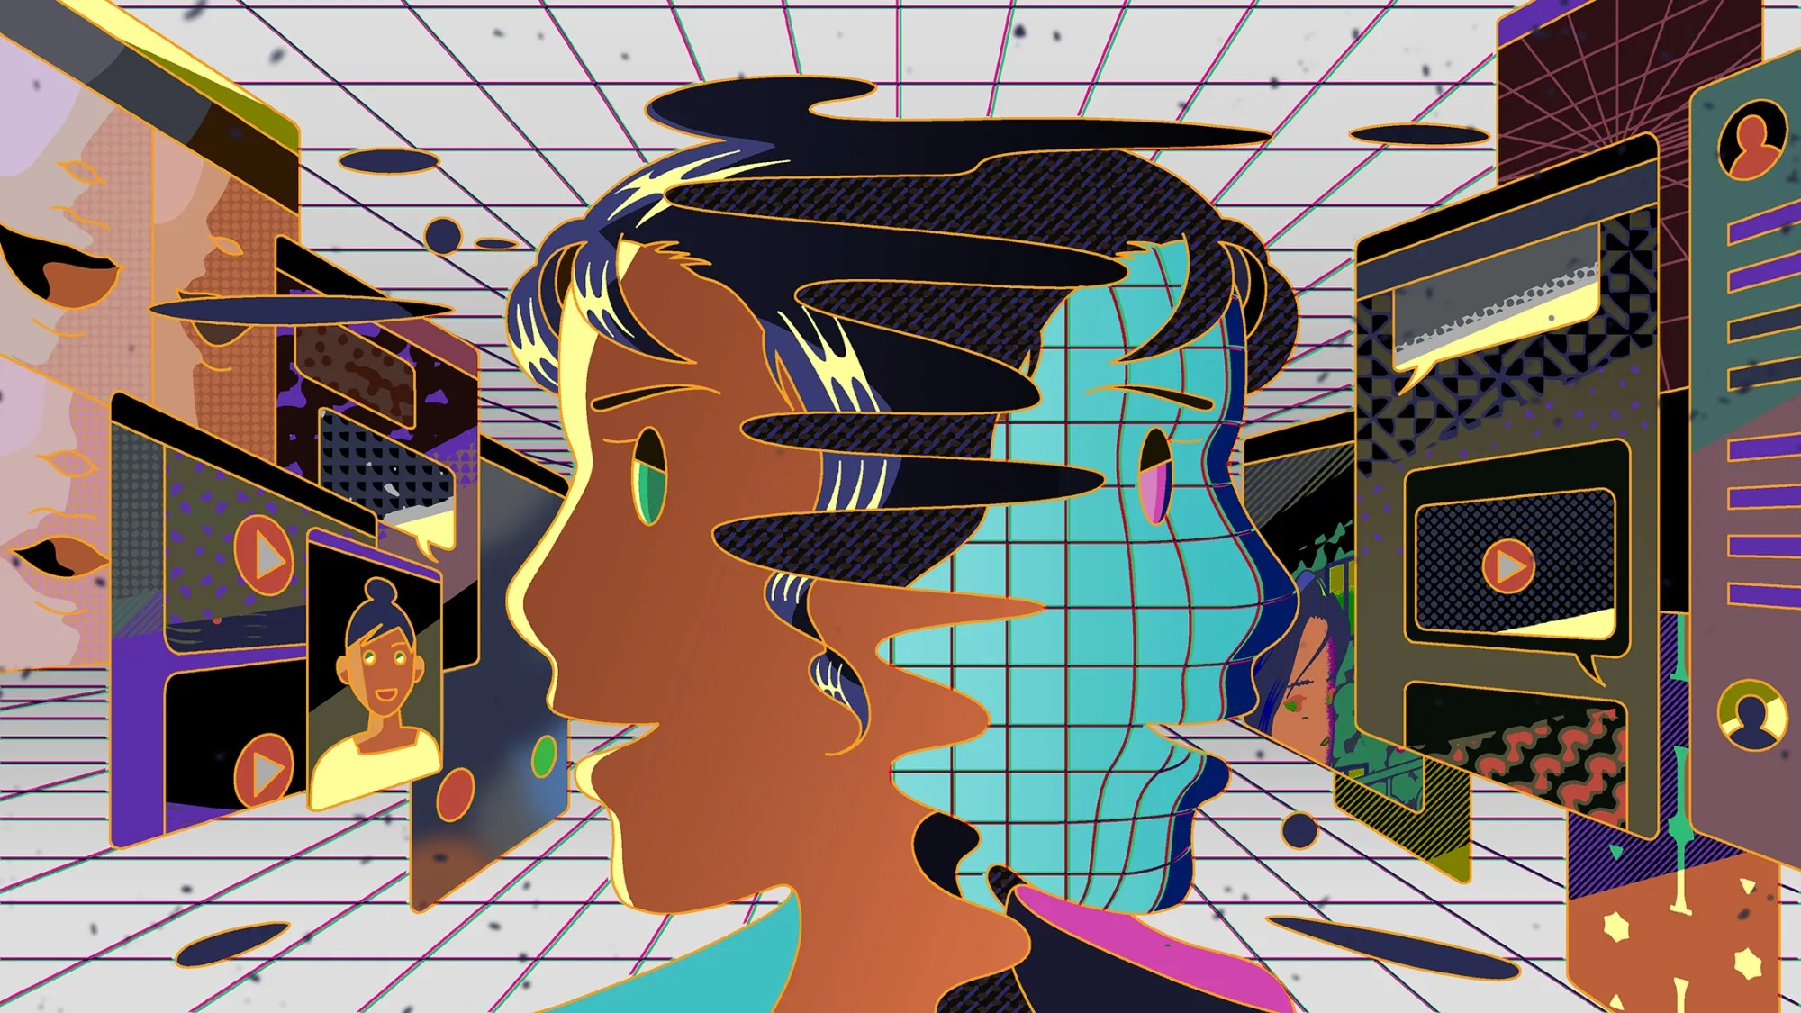
Main Claim
Deepfake technology increases cybersecurity risks by enhancing social engineering attacks, requiring more advanced software-based detection methods.

Slide 3
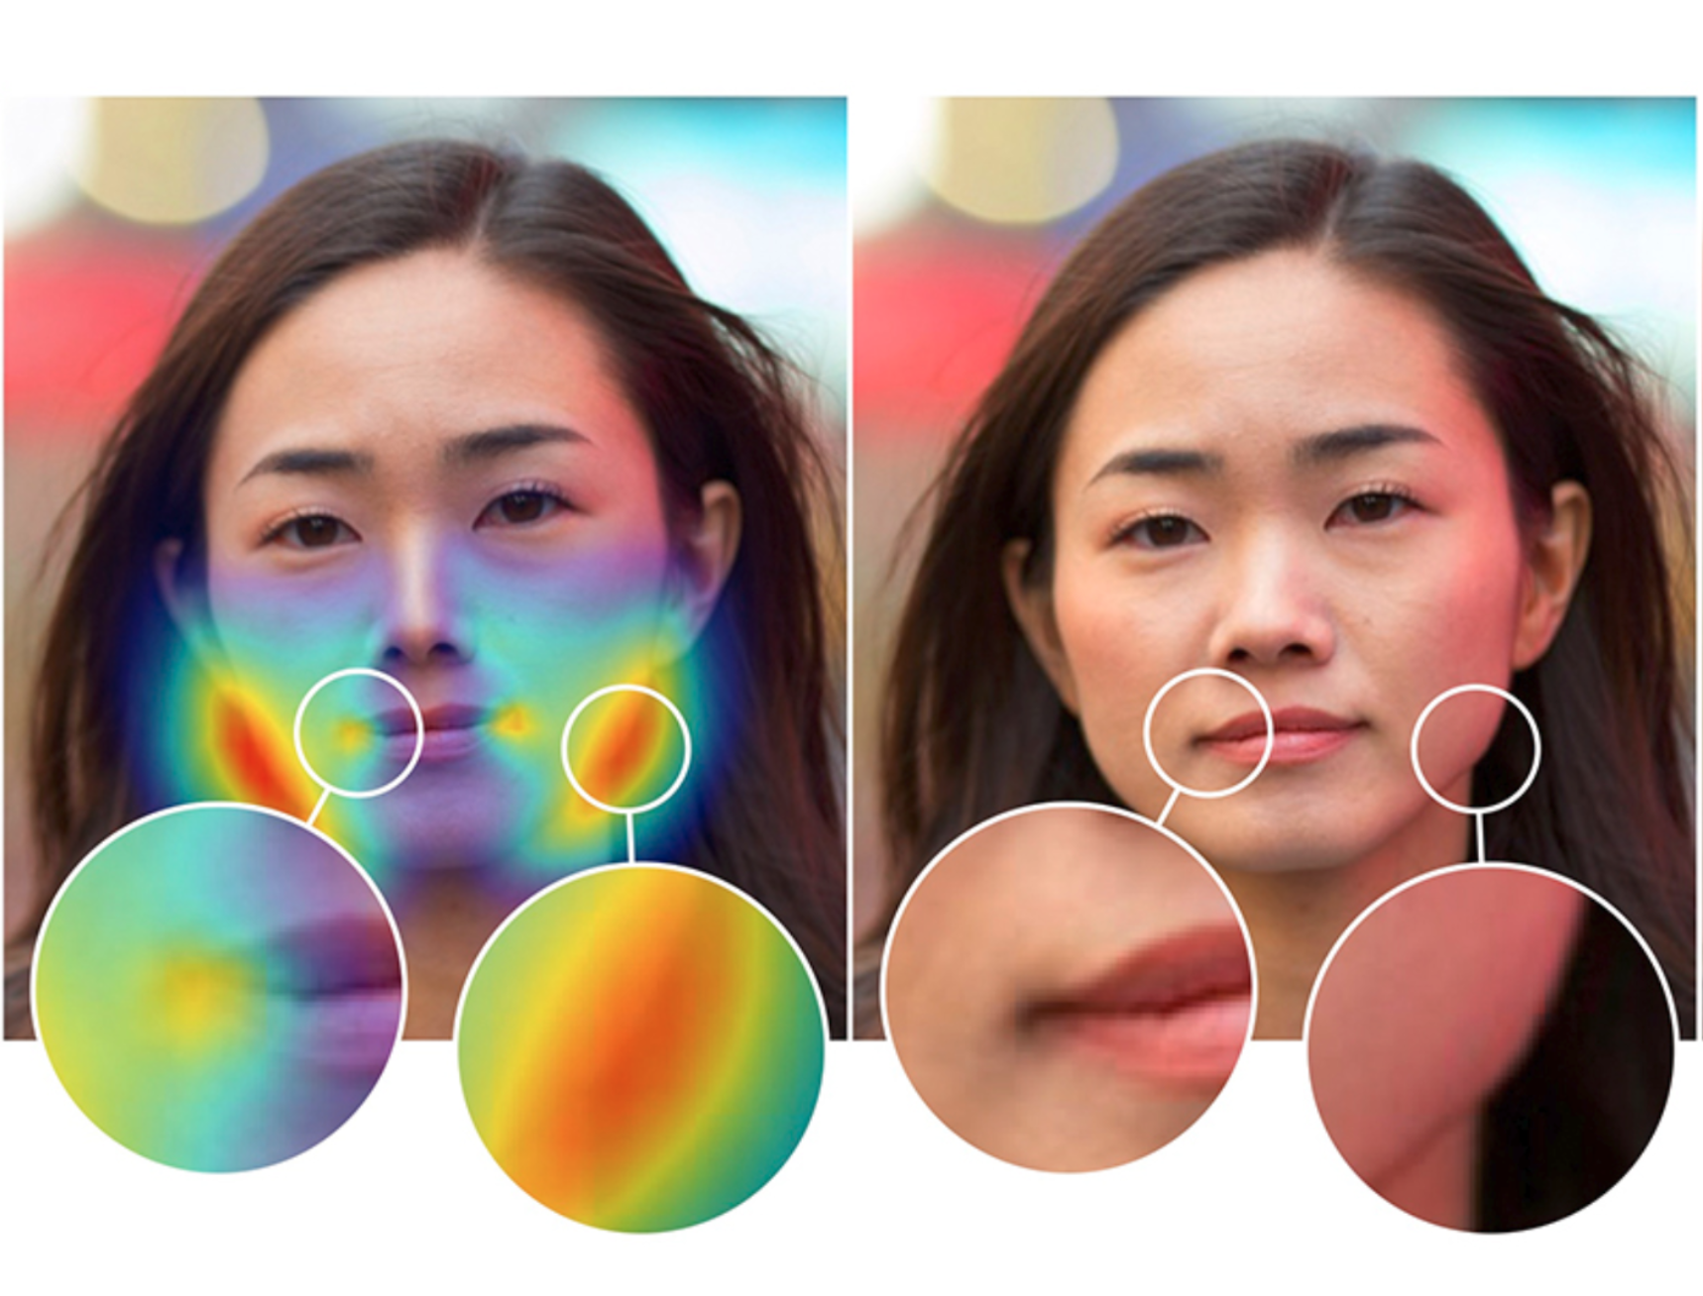
Introduction
What Are Deepfakes?
🎭 Hyper-Realistic Forgery
AI-generated media that imitates real people through synthetic video, audio, or images. [4]
Indistinguishable from authentic media to the untrained eye [4]
⚡ Rapid Generation
Producible at scale with minimal technical expertise [1]
🔐 Cybersecurity Threat
Actively weaponized in social engineering and fraud [2]

Slide 4
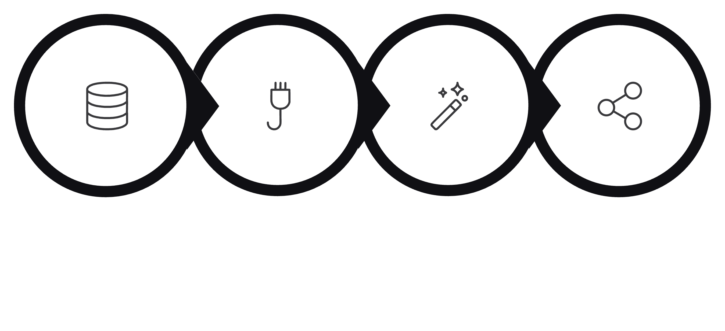
Technical Foundation
How Deepfakes Work
Data Collection
Images, videos, and voice samples are gathered to train AI models. [4]
GAN Training
Generator and discriminator networks compete to improve realism. [4]
Synthesis
AI creates cloned voices, face swaps, and synthetic expressions. [1],[4]
Data Collection
GAN Training
Synthesis
Deployment
Deployment
Deepfakes are distributed through phishing, social media, or fraud attacks. [1],[2]
Generative Adversarial Networks (GANs) and Deep Learning models generate realistic synthetic media and cloned voices. [4]

Slide 5
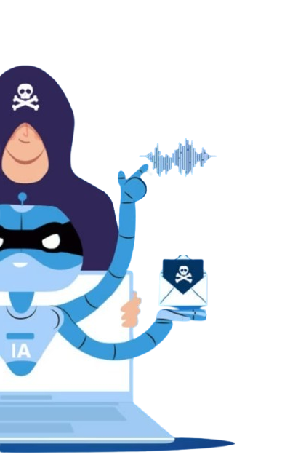
Attack Vectors
Deepfakes in Social Engineering
Spear Phishing
Personalized fake emails and credential theft [1]
Vishing
AI-cloned executive voice calls [2],[3]
Executive Impersonation
Synthetic videos authorizing fraud [1],[3]
Emotional Manipulation
Fake emergencies exploiting panic [5]

Slide 6

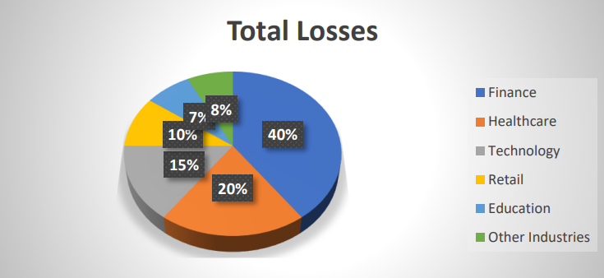
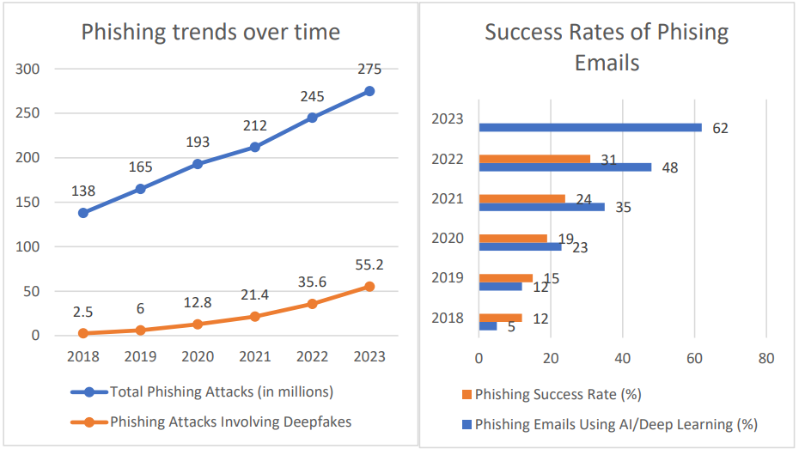
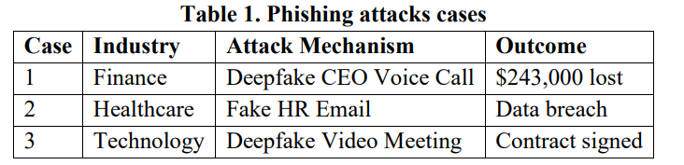
Real-World Cybersecurity Incidents
Financial Impact: Deepfake-enabled fraud is causing severe financial losses, with attacks rising sharply since 2022. [1],[3]
39

Slide 7



Defense Mechanisms
Existing Detection Methods and Countermeasures
🤖 AI-Assisted
Phishing Filters
🔬 Facial Landmark Analysis
Human + AI Verification: Automated AI detection combined with human oversight provides the strongest defense against deepfake attacks. [2],[3],[5]
Detects suspicious patterns in AI-generated phishing content. [1]
Detects abnormal facial movement. [3]
🔒 Zero-Trust
👄 Lip-Sync Verification
Limits successful impersonation attacks. [3]
Identifies audio-video mismatches. [5]

Slide 8


Summary and a Look to the Future
Deepfakes are no longer experimental threats, they are operational cyber weapons.
Confirmed Threat
Proven Danger
Defense Imperative
Deepfakes have transformed social engineering into a more convincing and dangerous form of cyberattack.
The combination of realism, emotional manipulation, and rapid online spread makes deepfakes difficult to resist.
Future cybersecurity will rely on AI verification, stronger security systems, and public awareness.

Slide 9
Bibliography
[1] S. K. Jampani, "Social Engineering 2.0 Deepfake and Deep Learning-Based Cyber-Attacks (Phishing)," Int. J. For Multidisciplinary Research, vol. 7, issue 1, Jan. 2025.
[2] A. Benusi and G. Selgjekaj, "A Practical Analysis of Social Engineering Attacks and Deepfakes," CEUR Workshop Proceedings, 2025.
[3] F. Hernandez, "Deepfake Technology in Corporate Cybersecurity: Emerging Threats and Defense Mechanisms," ResearchGate, Dec. 2024.
[4] M. Westerlund, "The Emergence of Deepfake Technology: A New Threat to Cybersecurity," Business Horizons, vol. 9, issue 11, pp. 39–52, Nov. 2019.
[5] P. Yemmireddi and Dr. Madumitha K, "When AI Lies: Deepfake as a Threat to Cybersecurity and Digital Trust," Int. J. Sci. Technol., vol. 16, issue 4, 2025.

Slide 10
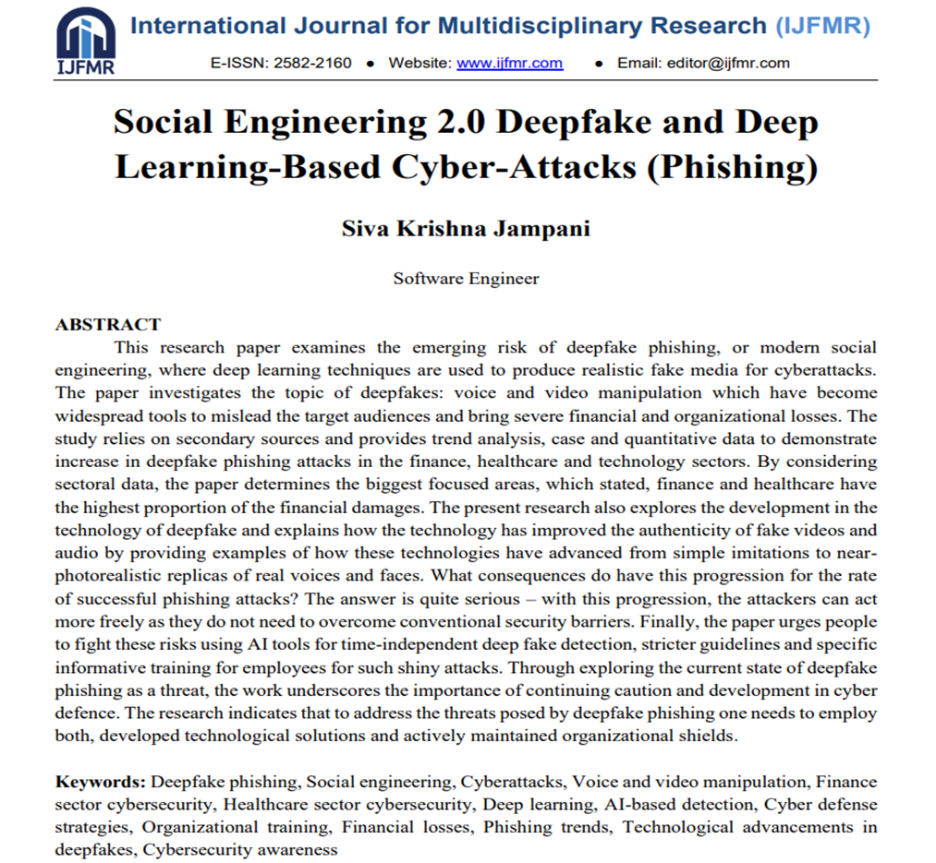
Oral Analysis Article
S. K. Jampani, "Social Engineering 2.0 Deepfake and Deep Learning-Based Cyber-Attacks (Phishing)," Int. J. For Multidisciplinary Research, vol. 7, issue 1, Jan. 2025.

